Slide 1

Scapy
CNIT 48101
Topic

Slide 2
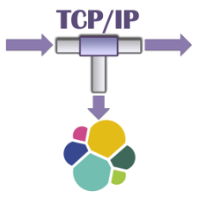
Scapy Intro
Powerful packet manipulation library
Developed by secdev
https://scapy.net/
Uses:
Automated packet capture sessions
Automatically sending packet data to different applications
Creating packets
Automated network scans

Slide 3



Advantages
Powerful
Can write, read and even create packets
Has built in network visualization functions
Is useful for red team and blue team functions.

Slide 4

Disadvantages
Not as easy to use
limited documentation

Slide 5
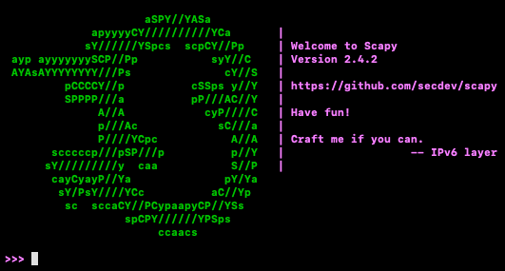
Scapy from command line
Scapy has its own command line interface which uses python. To start it just type:
Linux
sudo ./scapy
OSX
scapy
Windows cmd
C:\>scapy

Slide 6
Scapy Help
The best source of information is from Scapy’s help() function in the Scapy CLI. Simply type:
help(<module> <function> <topic>)
You can also just type help()with no parameters to enter the command line’s help mode.
Additionally, you can type lsc()in the Scapy CLI to see a list of functions
lsc()

Slide 7
Getting started
Install scapy
pip install scapy
Import the scapy module
from scapy.all import *

Slide 8
Reading pcap files with Scapy
Use rdpcap() or sniff(offline) to read packets from pcap files
rdpcap(‘<input file>’)
or
sniff(offline= ‘<input file>’)
Use sniff() if you plan to apply filters

Slide 9

Capturing packets with Scapy
Live capture packets using the sniff() function.
sniff()

Slide 10
Sniff() Optional Parameters
<srt/str array> iface:This specifies the interface(s) to sniff on. You can pass it an array for multiple interfaces. Defaults to whatever is specified on your conf.iface
<int> count:This specifies the number of packets to capture
<int> timeout:stops sniffing after specified amount of time passes
<bool> monitor:Turns on monitor mode. Not available in all OS
<str> filter: A BPF filter to apply
<bool> store: Store sniffed packets or discard them.
<str> offline: for reading from files
<function> sprintf: function allowing you to control how packet data is printed

Slide 11
Sniff() Optional Parameters (cont.)
<function> prn: function to be applied to all packets as they come in.
<function> started_callback:A function to be called as soon as sniffing begins
<function> lfilter:function applied to each packet that determines if further action may be done
<function> stop_filter:function applied to each packet to determine whether to stop sniffing after the sniffed packet.
<object> L2socket:Use the L2socket supplied. Defaults to “use L2conf.listen”
<object/ object list> opened_socket:Calls .recv() function on provided objects for send and receive pairs

Slide 12
Sniff() Optional Parameters (cont.)
sniff() allows you to determine how to dissect packets through the <str> session parameter
sniff(session = ‘<session>’)
While you can create your own custom sessions, Scapy supports two native sessions:
defragment: IP packets on-the-flow, to make a stream usable by prn
NetflowSession: resolve Netflow V9 packets from their NetflowFlowset information objects

Slide 13
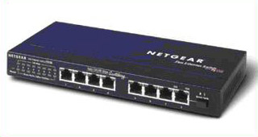
bridge_and_sniff()
Forward packets between two interfaces and monitors the exchanged packets
scapy.bridge_and_sniff(<interface 1>,<interface 2>)
Required Params
<str> if1: First interface
<str> if2: Second interface

Slide 14
bridge_and_sniff() (cont.)
Optional Params
<function> ifrm12: A function specifying whether or not to forward a packet from interface 1 to interface 2. If the function returns a packet, the returned packet is forwarded instead
<function> ifrm21: same thing as ifrm12 but for packets being forwarded from interface 2 to 1

Slide 15
Packet List Class
The packet capture creates a PacketList object which is a list that contains all of the captured packets
capture = sniff()
There are several helpful class functions that can be done on the PacketList object. We will only cover the main functions here but you can see all of them by typing in Scapy’s CLI:
help(PacketList)

Slide 16
Packet List methods
.show(): prints all the packets in the PacketList
.summary(): prints a summary of each packet
.nsummary(<lfilter>): prints a summary of each packet with the packet’s number
.hexdump(<lfilter>): dumps the hex of all the packets
.rawhexdump(): prints a hexdecimal dump of each packet
.filter(<filter>): takes in a filters to filter all the packets in the list
.padding(<lfilter>):hex dumps the padding layer of each packet
.nzpadding(<lfilter>): hex dumps non-null padding

Slide 17
Packet List methods (cont.)
There are also functions that can automatically create graphs. Most of these functions require you pass parameters that describe the graph axis and pass function which to graph. These functions also may require external dependencies.
.conversations(): graphs conversations between source and destination
.timeskew_graph(): matches the timeskew between each packet
.make_table(): prints a table according to a given function
.plot(): passes packets through a given function and plots the results

Slide 18
Accessing Packet Data
Similar to pyshark, packets can be accessed using a loop or individual packets can be indexed:
for packet in capture:
packet.show()
or
capture[0].show()

Slide 19
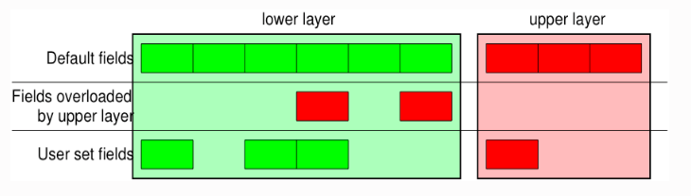
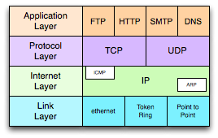
Packet Structure
Much like pyshark, the structure of a packet object, each layer of a packet is a dictionary. With Scapy, some fields of the upper level packets can override the fields of the lower level packets

Slide 20

Creating Packets
Scapy’s true power lies in its ability to create and send packets. This allows us to:
probe various network using custom traffic
stress test our network
perform various network scans

Slide 21
Creating a Packet
You can start at any layer you want but it is up to you that craft a valid packet. Creating packets follow this general syntax:
<layer>(<params>)
For example this builds an IP layer with source 127.0.0.1:
a = IP(src= ‘127.0.0.1’)
>> <IP src=127.0.0.1>

Slide 22
Creating a Packet (cont.)
You can stack multiple packet layers to start completing your packet using /. Certain packet fields will automatically be filled out for you.
a/TCP()
>> <IP frag=0 proto=tcp src=127.0.0.1 |<TCP|>>
We added a TCP layer to our packet from earlier. Notice how our IP field autofilled the proto field

Slide 23
Generating sets of Packets
You can define functions that can create entire sets of Packets.
Generates packets with TTL from 1-7
a=IP(ttl=(1,3))
[p for p in a]
>> [<IP ttl=1>,<IP ttl=2>,<IP ttl=3>]
Generates IP packets whose destination fall under .30 subnet for slashdot.org
a=IP(dst="www.slashdot.org/30")

Slide 24
Fuzzing Packets
If you don’t want to worry about manually filling out all fields of the packet, you can use the fuzz() function. It will fill in any non-calculated fields with random but valid data based on the currently filled fields.
Fuzzes the UDP field of the packet
fuzz(UDP())
In order to randomize the src and destination IP address in the IP layer, use RandIP()

Slide 25
Packet Class methods
Only the main functions are shown here. Run help(Packet) for more info.
.show():prints a hierarchical view of the packet
.summary(): prints a one line summary of the packet
.sprintf(<function>): prints packet data according to a custom function
.haslayer(<class>): returns true if the packet contains the specified layer
.add_payload(<str>): adds a payload to the packet
.command():returns the scapy command required to create the same packet
.copy():creates a copy of the packet
.copy_field_value(): copies the value of a specific field

Slide 26
Packet Class methods (cont.)
There are also several useful methods for automated reporting. These methods require certain external Python libraries. Running the function should tell you which libraries are needed.
.pdfdump(<file path>): creates a pdf file describing the packet. Takes in an optional file path
.psdump(<filename>): creates a eps file describing the packet. Takes in an optional file path
.svgdump():creates a svg file describing the packet. Takes in an optional file path

Slide 27




Sending packets
Scapy can send packets in many different ways. To see all the different packet sending methods type in the Scapy CLI:
lsc()

Slide 28
send()
Sends Layer 3 packets.
send()
Required Params
<packet> x: packet or packets to send
Optional Params
<int> loop: keep resending packets. False if 0 otherwise true
<str> iface: interface from which to send packets
<int> inter: interval of time between packets sent

Slide 29
send() (cont.)
<bool> return_packets: Default false. Returns sent packets
<int> verbose: set verbocity level
<socket class> socket: use socket connection to send packets

Slide 30

send() variants
sendp(): like send() but for Layer 2 packets
sendpfast(): like sendp() but uses tcpreplay for performance

Slide 31
sr()
Short for send and receive. Sends and received layer 3 packets Creates a dictionary that contains answered and unanswered packets
sr()
Required Params
<Packet> x: packet or list of packets to send
Optional Params
<int> nofilter: put 1 to avoid using BPF filters
<int> retry: if positive, how many times to resend unanswered packets, if negative how many times to retry when no more packets are answered

Slide 32
sr() (cont.)
<int> timeout: how much time to wait after the last packet is sent
<int> verbose: set verbosity level.
<bool> multi: whether to accept multiple answers for the same packet
<str> filter: provide a BPF filter
<bool> store_unanswered: whether or not to store unanswered packets. Defaults is True
<function> process: function that allows you to modify a sent packet and its corresponding answer. Takes in a sent and received packet.

Slide 33
sr() variants
sr1(): send packets at Layer 3 but only return the first answer
srp(): Like sr() but for Layer 2 packets
srp1(): Like sr1() but for Layer 2 packets
srloop(): Like sr() but continuously prints the results as they come in. For Layer 3 packets.
srploop(): Like srloop() but for Layer 2 packets

Slide 34

Important network scans
Since scapy can send and receive packet, it is capable of conducting a variety of different network scans

Slide 35
Synscan
Synscan sends a syn packet to various ports and checks to see if it receives a response. If it does, that means the port is open
report_ports(<ip address>,(<port range>))
Scans IP address 192.168.1.1 from ports 80 to 443
report_ports(‘192.168.1.1’,(80,443))

Slide 36
Traceroute
Traceroute allows you to see the route a packet takes to reach its destination. The function returns a list of packets generated along the route as well as any unanswered packets.
traceroute(<destination ip>)
Trace route to ‘8.8.8.8’
traceroute(‘8.8.8.8’)
For IPV6 use:
traceroute6(<destination ipv6>)

Slide 37
ARPing
Send arp who-has requests to see which hosts are up
arping(<network segment>)
Scans the 192.168.1.0/24 subnet for active hosts
arping(‘192.168.1.0/24’)

Slide 38
Conclusion
Scapy is a large tool with so many features that it can fill an entire course. We’ve barely touched the surface of Scapy’s capabilities. In the developer’s own words:
It can easily handle most classical tasks like scanning, tracerouting, probing, unit tests, attacks or network discovery (it can replace hping, 85% of nmap, arpspoof, arp-sk, arping, tcpdump, tethereal, p0f, etc.). It also performs very well at a lot of other specific tasks that most other tools can’t handle, like sending invalid frames, injecting your own 802.11 frames, combining technics (VLAN hopping+ARP cache poisoning, VOIP decoding on WEP encrypted channel, …)
You are highly encouraged to explore Scapy more.
https://scapy.readthedocs.io/en/latest/usage.html

